Slide 1

Problem Solving skills
Course Code: CSC -101 Credit Hrs:3+1
Course Teacher: Noman Atique/Muhammad Shahzad/ Javeria Farooq

Slide 2
Flowchart for Basic Logic Structures
Sequence
Decision
Repetition

Slide 3
Sequence Structure
A series of actions are performed in sequence.

Slide 4
Decision

Slide 5
Selection Logic
Also known as decision logic, it is used for making decisions.
A decision symbol is used in flowchart to indicate a point at which a decision has to be made.
Three popularly used selection logic structures are
1.IF…..THEN
2.IF….THEN….ELSE
3.SWITCH CASE

Slide 6
IF…..THEN
IF Condition
THEN Process 1
END IF
Is I=10?
True
False
Process 1

Slide 7
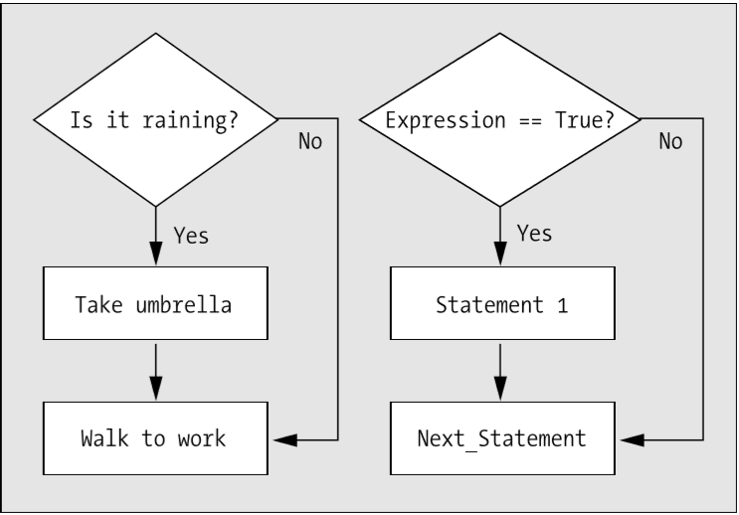
IF….THEN

Slide 8
IF….THEN….ELSE
IF Condition
THEN Process 1
ELSE Process 2
END IF
Is I=10?
True
False
Process 1
Process 2

Slide 9
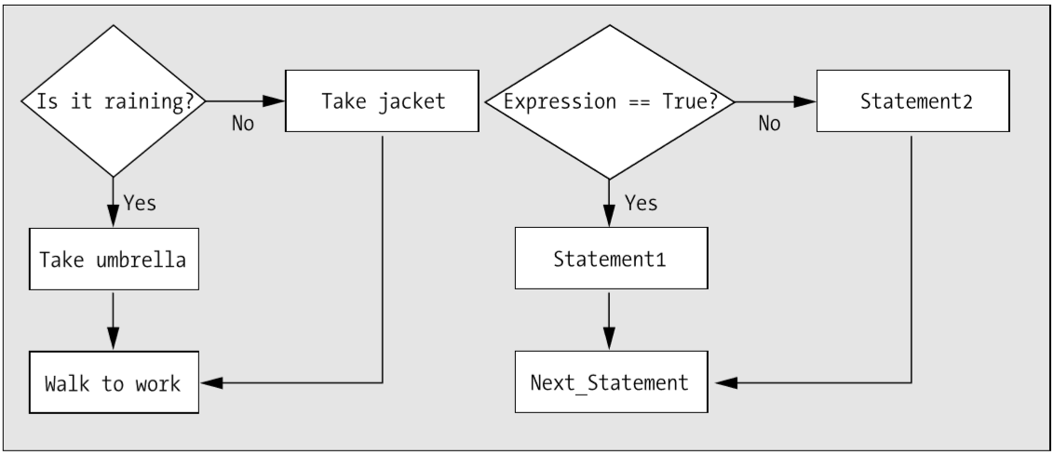
IF…..THEN…ELSE

Slide 10
SWITCH CASE
If years employed = 2, bonus is set to 200
If years employed = 3, bonus is set to 400
If years employed = 1, bonus is set to 100
If years employed is any other value, bonus is set to 800
CASE years employed
1
2
3
Other
bonus = 100
bonus = 200
bonus = 400
bonus = 800

Slide 11
Sample Decision(Example 1)
Write an algorithm to print the square of a number if it is less than 10.
Start
Algorithm
Step1: Start
Step 2: Read num1.
Step 3: if num1<10
then
square num1*num1
Print square
endif
Step 4: End
Read num1
If num1<10
True
square=num1*num1
False
Print square
Stop

Slide 12
Sample Decision(Example 2)
Write an algorithm to determine a student’s final grade and indicate whether it is passing or failing. The final grade is calculated as the average of four marks.
START
Algorithm
Step 1: Start
Step 2: Input M1,M2,M3,M4
Step 3: GRADE ← (M1+M2+M3+M4)/4
Step 4: if (GRADE < 50)
then
Print “FAIL”
else
Print “PASS”
endif
Step 5: Stop
Input
M1,M2,M3,M4
GRADE←(M1+M2+M3+M4)/4
False
IF
GRADE <50
True
Print “Pass”
Print “FAIL”
PRINT
“PASS”
PRINT
“FAIL”
STOP
Notes:
Pseudocode
Input a set of 4 marks
Calculate their average by summing and dividing by 4
if average is below 50
Print “FAIL”
else
Print “PASS”

Slide 13
Sample Decision (Example 3)
Write an algorithm that reads two values, determines the largest value and prints the largest value with an identifying message.

Slide 14
Sample Decision(Example 3)
START
Input
VALUE1,VALUE2
Algorithm
Step 1: Start
Step 2: Input VALUE1, VALUE2
Step 3: if (VALUE1 > VALUE2)
then
MAX ← VALUE1
else
MAX ← VALUE2
endif
Step 4: Print “The largest value is”, MAX
Step 5: Stop
False
N
is
VALUE1>VALUE2
True
MAX ← VALUE2
MAX ← VALUE1
Print “The largest value is “, MAX
STOP

Slide 15
Exercises
Design a flowchart and an algorithm for the Drivers License (Keeping in mind all the requirements and restriction).
2. Design an algorithm and flowchart which breaks the number into digits and sum up those digits.
For e.g. 27 2+7=9
3. Design a flowchart and an algorithm to find either the entered number is even or odd
4. Design an algorithm and flowchart that computes the absolute difference of two values (X and Y), where the difference is (X-Y) or (Y-X), whichever is positive.

Slide 16
5. A company that issues check-cashing cards uses an algorithm to create card numbers. The algorithm adds the digits of a four-digit number, and then adds a fifth digit of 0 or 1 to make the sum of the digits even. The last digit in the number is called the check digit. Complete the seven problem-solving steps to develop a solution that accepts a four-digit number into one variable, adds the check digit, and prints the original number and the new number.
6. Design the algorithm and flowchart to check either the user entered number is palindrome or not.
10201 is a palindrome number because its reverse is equal to the original number i.e., 10201

Slide 17
7. Kolachi restaurant has started charging for valet parking. For parking, they have announced the following rules.
Normal charges=50 Rs.
For cars which stay for 60 minutes or less than 60 minutes, owner has to pay normal charges. For cars which stay for more 60 minutes but less than 120 minutes, owner has to pay double of normal charges along with normal charges.
For cars which stay for more than 120 minutes, owner has to pay the triple of the normal charges along with normal charges. Design an algorithm and flowchart to calculate the charges of valet parking

Slide 18
8. You need to design a system which should calculate the number of calories a person should eat each day. Calories are units of energy found in all foods. Base your recommendation on the person's weight and whether the person has an active or sedentary (inactive) lifestyle. If the person is sedentary, that person's activity factor is 12. If the person is active, that person's activity factor is 15. Multiply the activity factor by the person's weight to get the recommended number of calories. Consider the following rules for designing a system.

